Slide 1
GEOG 392/676 GIS Programing Lab6
Zhenlei Song, Ph.D Student
Department of Geography
Email: songzl@tamu.edu
Office: CSA 301F

Slide 2
Lab 6 Tasks
Implement an ArcGIS Pro Toolbox that:
Re-render the “Structures” layer using “UniqueValueRenderer”.
Re-render the “Trees” layer to “GraduatedColorsRenderer”.
Supports “Step” progressor.

Slide 3
Important Notes
Data Source
Use the “Campus.gdb” from Lab4/5. Load it in an ArcGIS Pro project manually. Use this project as the input of your code.
Tutorial & Reading material
https://github.com/TAMUCIDI/GEOG-392-GIS-Programming/blob/main/Labs/Lab06/Lab06.md
There is NO CODE TEMPLATE in this lab
Take these parameters in your toolbox:
The working project path
The layer's name
The output project path (Optional)

Slide 4
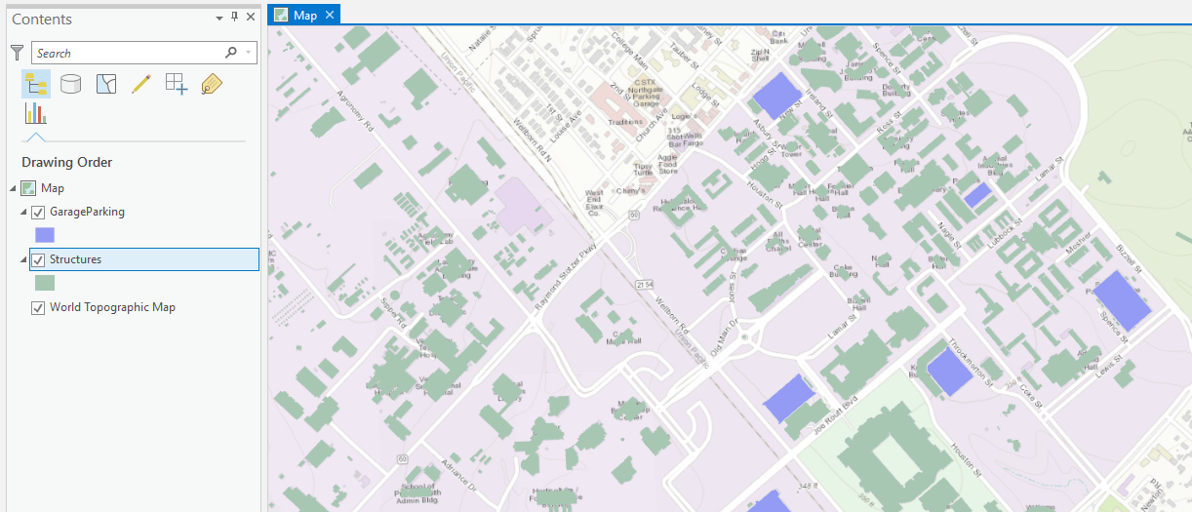
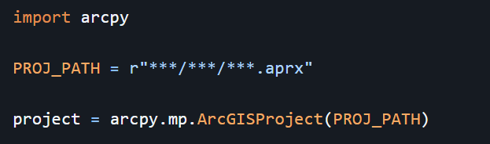
Part 1. Renderer
Init

Slide 5
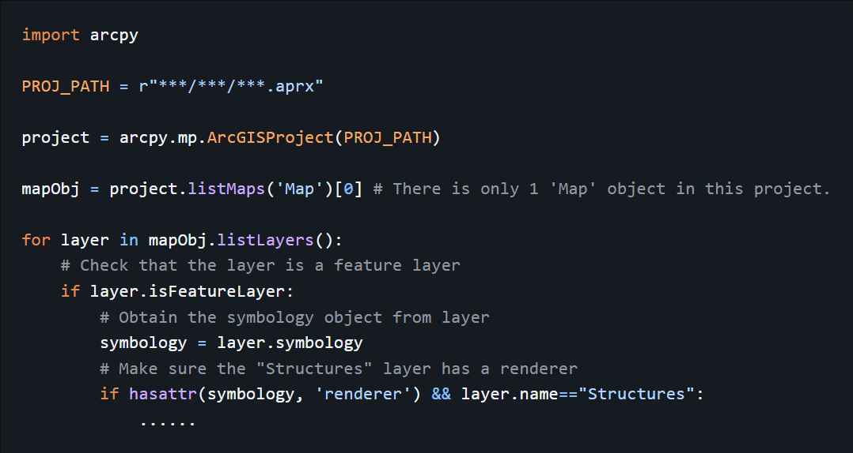
Part 1. Renderer
Fetch the feature layer
Project
Map
Layer list []
1. XXX
2. YYY
3. ‘Structures’
4. ‘Trees’

Slide 6
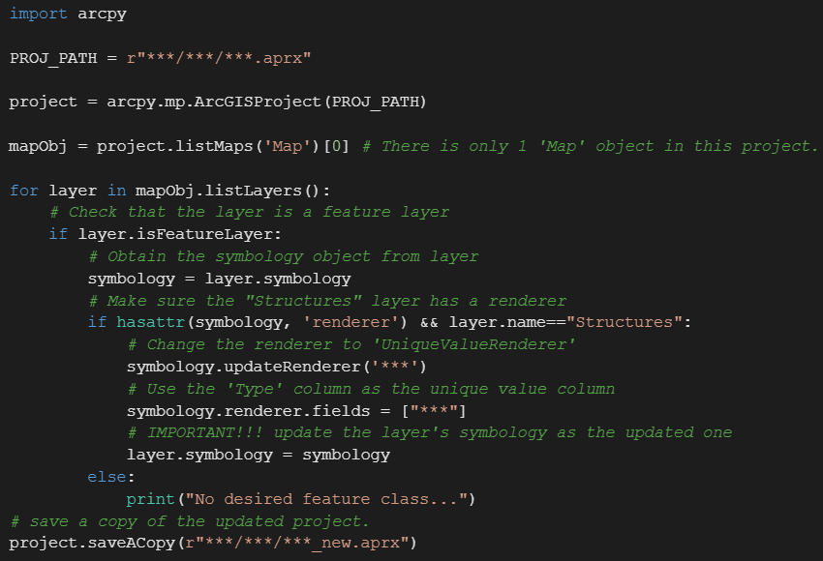
Part 1. Renderer
UniqueValueRenderer
Use `symbology.updateRenderer(‘UniqueValueRenderer’)` func to change the feature layer’s renderer.
Specify which field to be the unique values column.
Don’t forget to set the changed renderer back to the feature layer’s symbology object.

Slide 7
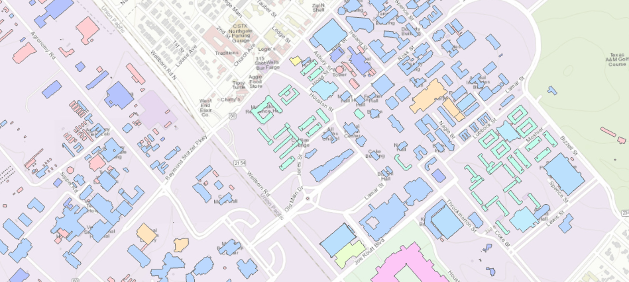
Part 1. Renderer
Result

Slide 8
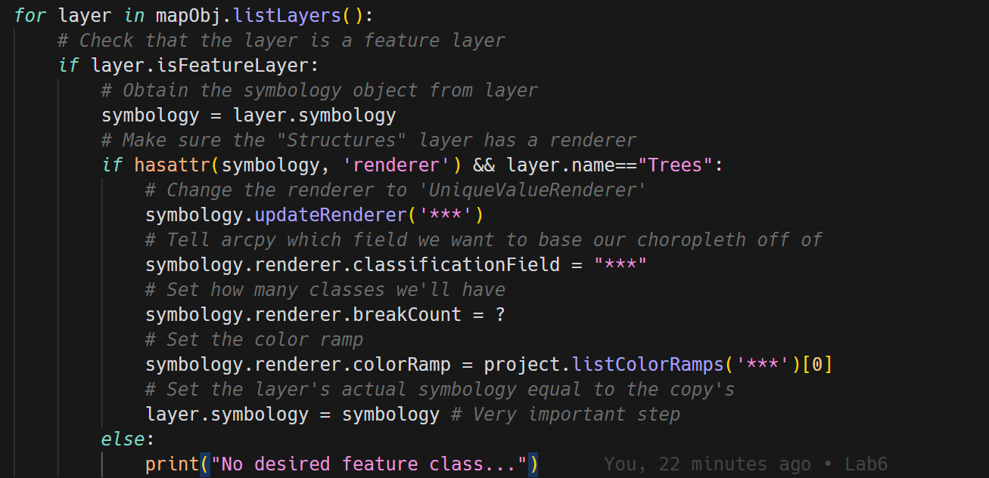
Part 1. Renderer
GraduatedColorsRenderer
Use `symbology.updateRenderer(‘GraduateColorsRenderer’)` func to change the feature layer’s renderer.
Specify
which field to be the classificationField column.
How many bins to break into.
Colormap setting
Don’t forget to set the changed renderer back to the feature layer’s symbology object.

Slide 9
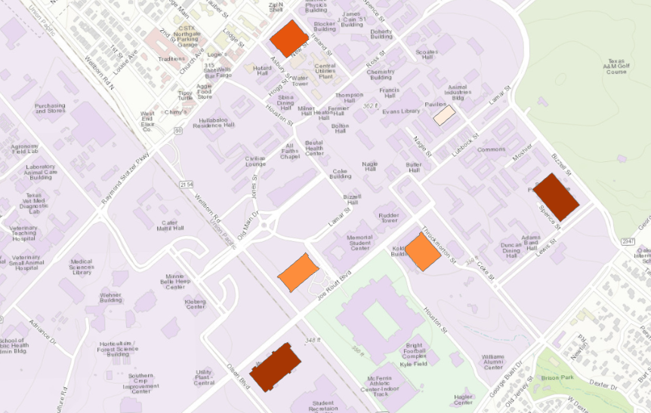
Part 1. Renderer
Result

Slide 10
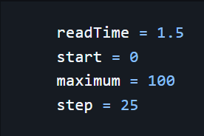
Part 2. Progressor
Init
Inside of the `Execute()` method, define the following var

Slide 11
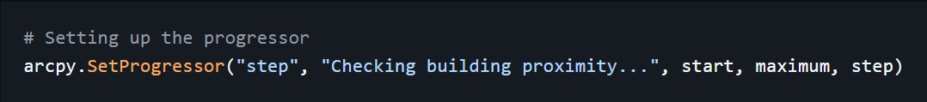
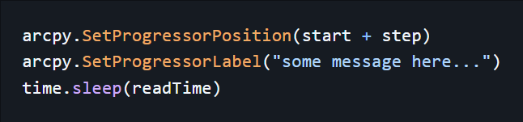
Part 2. Progressor
Methods
To init the progressor
To advance the progressor by step

Slide 12
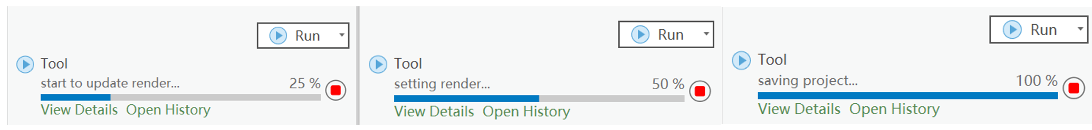
Part 2. Progressor
Result

Slide 13
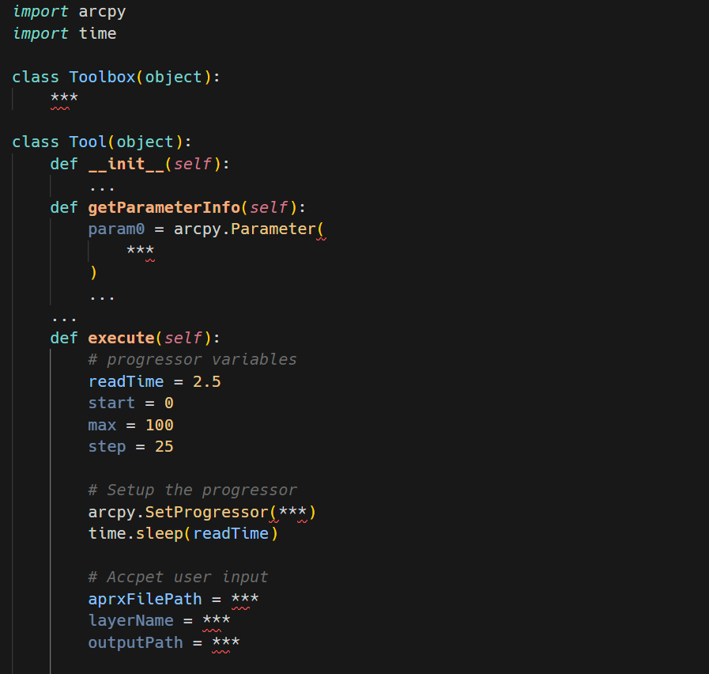
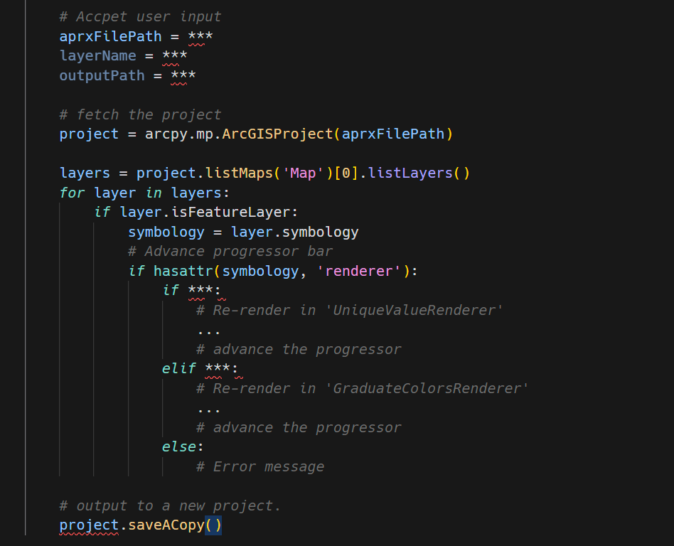
Your Code Stucture
Notes:
There is no code template this time but a code structure.
Read the materials carefully.

Slide 14
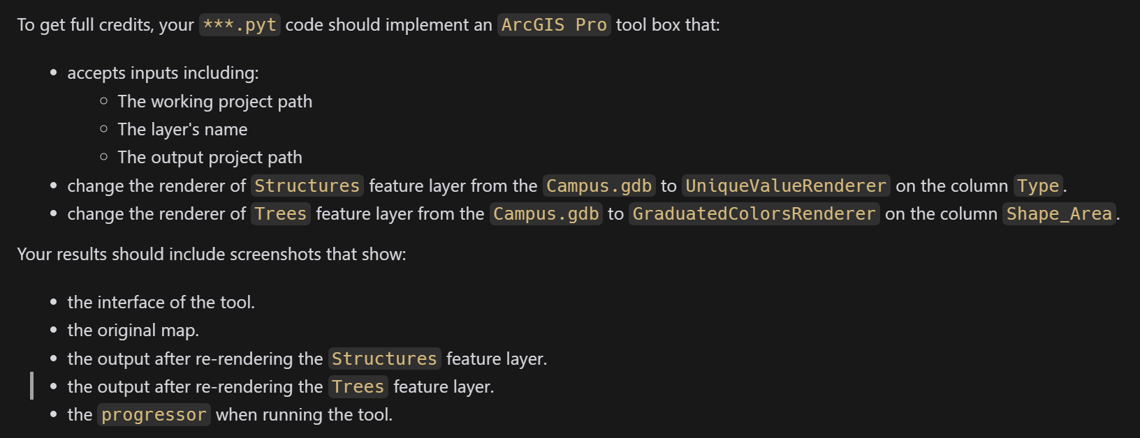
Submission
A PDF file includes:

Slide 15
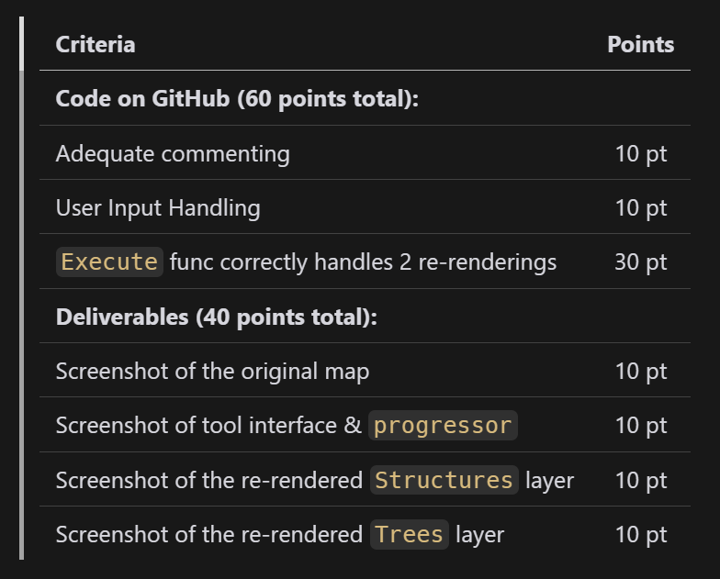
Grading Rule

Slide 16
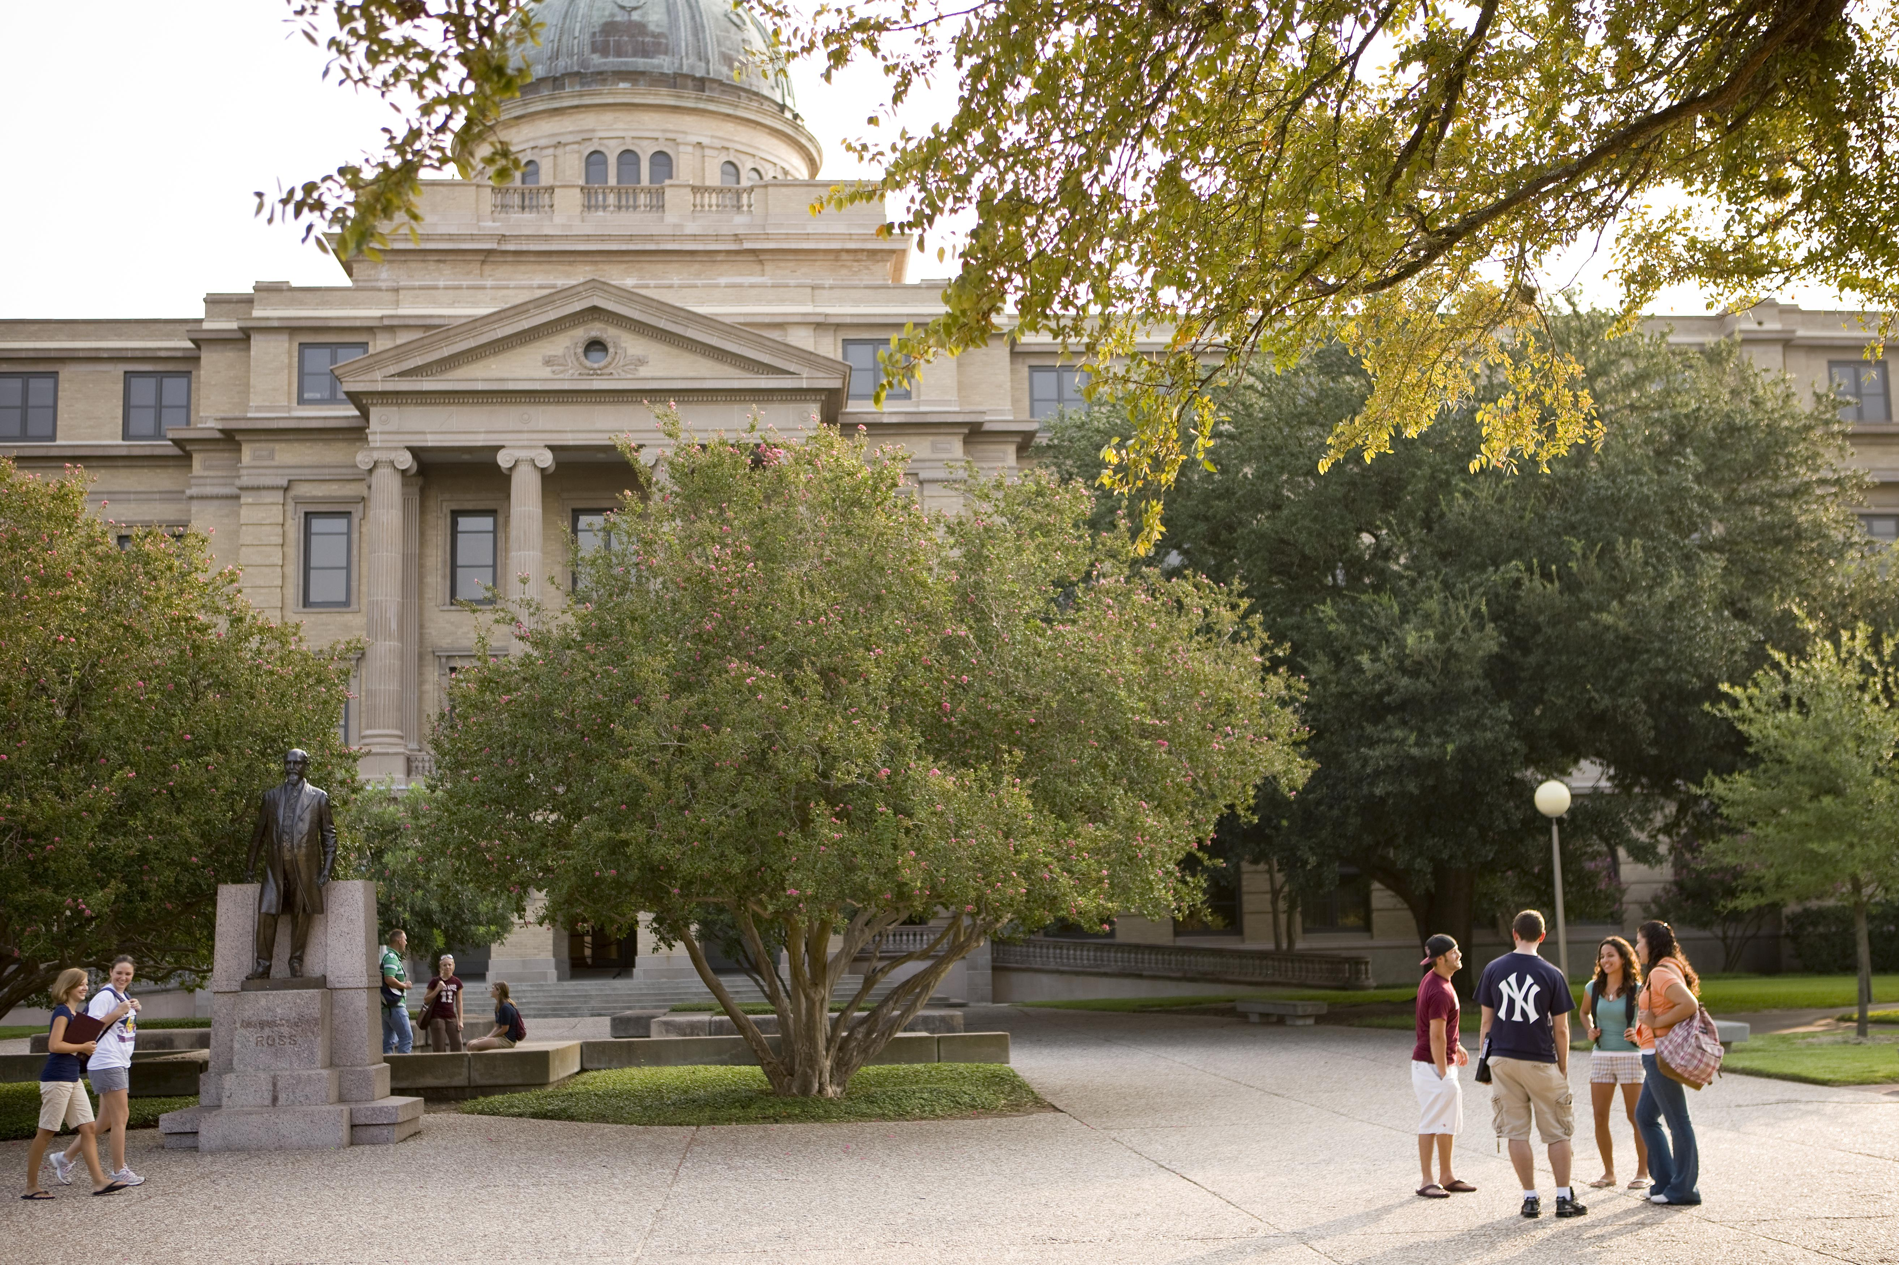
Additional Resources
Useful Links
arcgisproject-class
layer-class
colorramp-class
uniqueValueRenderer
graduatedColorsRenderer
progressor
VS Code Plugins
Python
Pylance
Python Debugger
Gitlens

Slide 17
The End

